Slide 1
An Introduction to Test Automation Framework
Mohamed Abdelwahab

Slide 2
Overview
Manual vs Automation
Automation Scope
Automation Solution «Development»
Automation Framework «Engine Usage»
Continuous Integration
Continuous Improvements

Slide 3
Manual vs Automation

Slide 4
Manual Problems
Long time Test Execution
More time required for test cycles
Short Regression coverage
Late feedback
Testers Not focus to new feature.

Slide 5
Automation Benefits
Shortening the test execution period
Increasing the test frequency/reducing the time required for test cycles
Providing wider Regression coverage
Quick feedback regarding software quality
Testers can focus on new features
Automate test data creation

Slide 6
Automation Scope

Slide 7
Automation Scope
End to End Scenarios [Smoke]
A set of most important tests [Regression]
Test for the most important Modules

Slide 8
Example: Bravo End To End Scenarios
Admin Login
Create supervisor
Create inspector
Create usergroup
Add users to usergroup
Create entitytype
Add fields to entitytype
Create new entitygroup
Create entity
Add entity to entitygroup
Create Form
Add fields with to form
Activate form
Create Workflow
Create Linkage
Supervisor Login
Supervisor distribute task
Inspector fill data
Inspector login
Inspector upload task
Supervisor take action on task

Slide 9
Set of Regression
Functionalities highly visible to users
Cases which verify core features of the product
Cases with frequent defects
Integration Test cases

Slide 10
Test for the most important Modules
Example Bravo most important modules
Task distribution
Incident Tasks
Visit Tracking (my Tasks)
Mobile Task Management
Workflow Builder
Form Builder

Slide 11
Automation Solution «Development»

Slide 12
Test Automation Solution
Keyword driven development
Development architecture
Development Tools

Slide 13
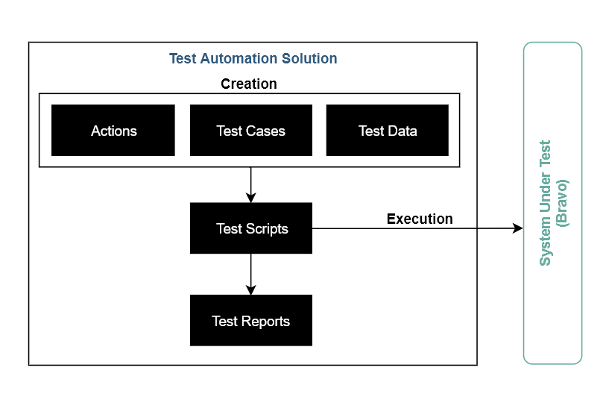
Keyword Driven Approach General

Slide 14
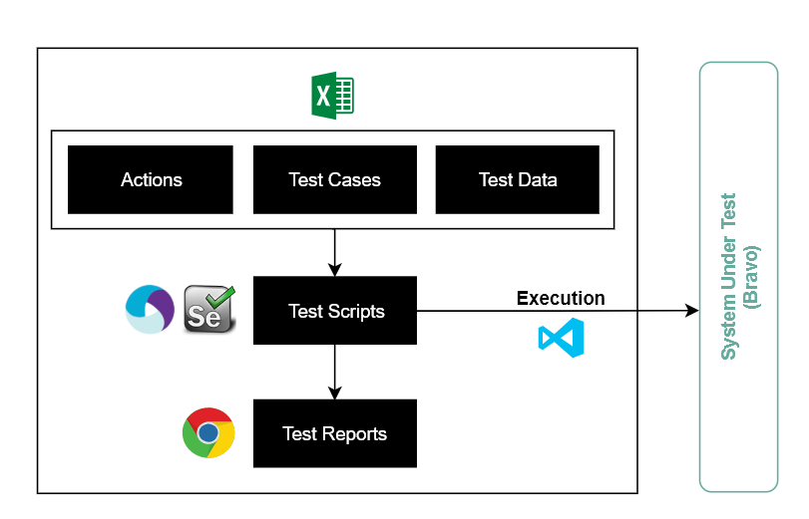
Keyword Driven Approach Current implementation

Slide 15
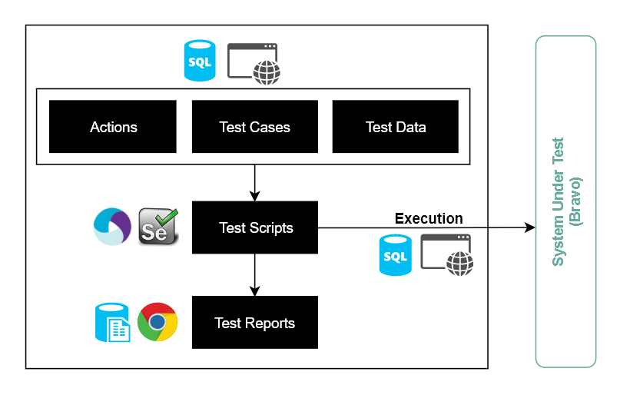
Keyword Driven Approach Future implementation

Slide 16
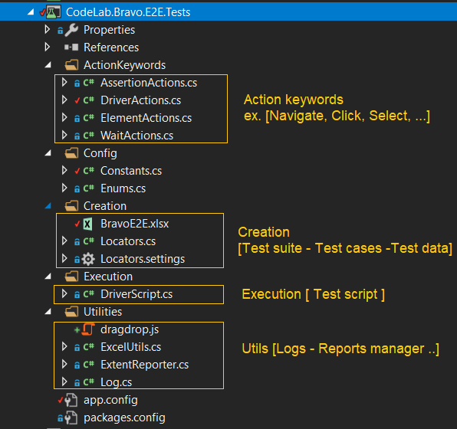
Development architecture Current implementation

Slide 17
Development tools
IDE/Coding
Visual studio
IntelliJ IDEA
C#
Java
JavaScript
Framework
Nunit
TestNG
Selenium
Appium
Mobile/Emulators
Android studio
Android SDK Manager
AVD Manager
Utilities
Excel
Extent Reports
Katalon
Version control
Git

Slide 18
Automation Framework «Engine Usage»

Slide 19
Test Automation Framework
Creation [Test suite – Test cases – Test data - Locators]
Execution
Monitoring
Reports
Logs

Slide 20
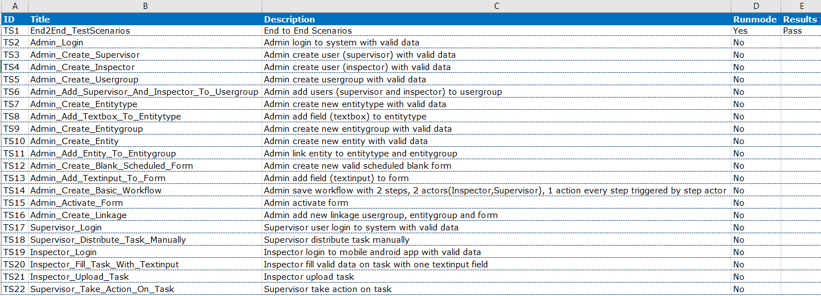
Test Suite Creation

Slide 21
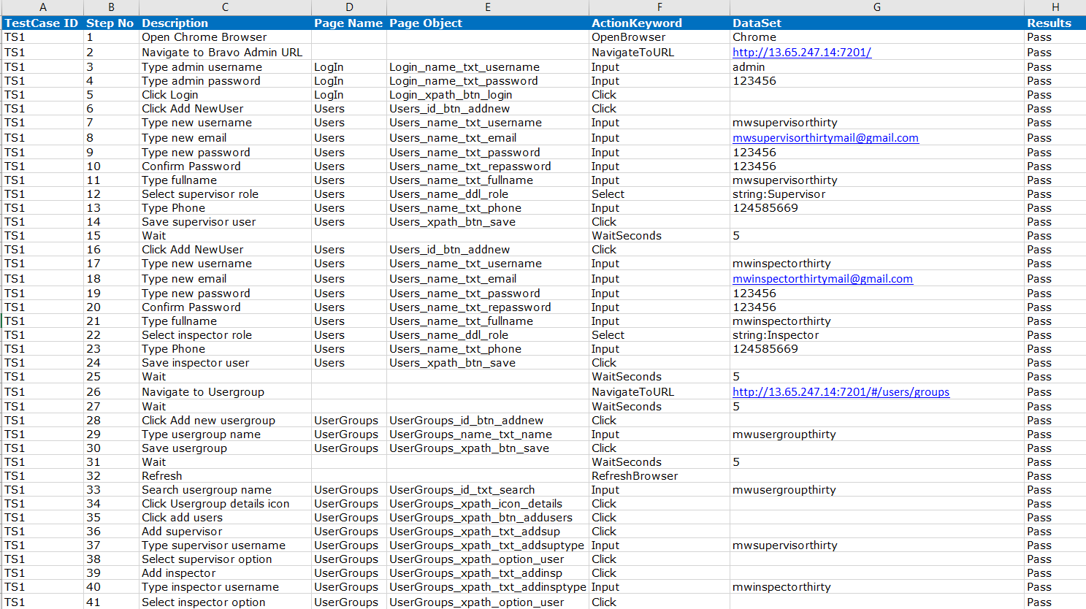
Test Case/Test Data Creation

Slide 22
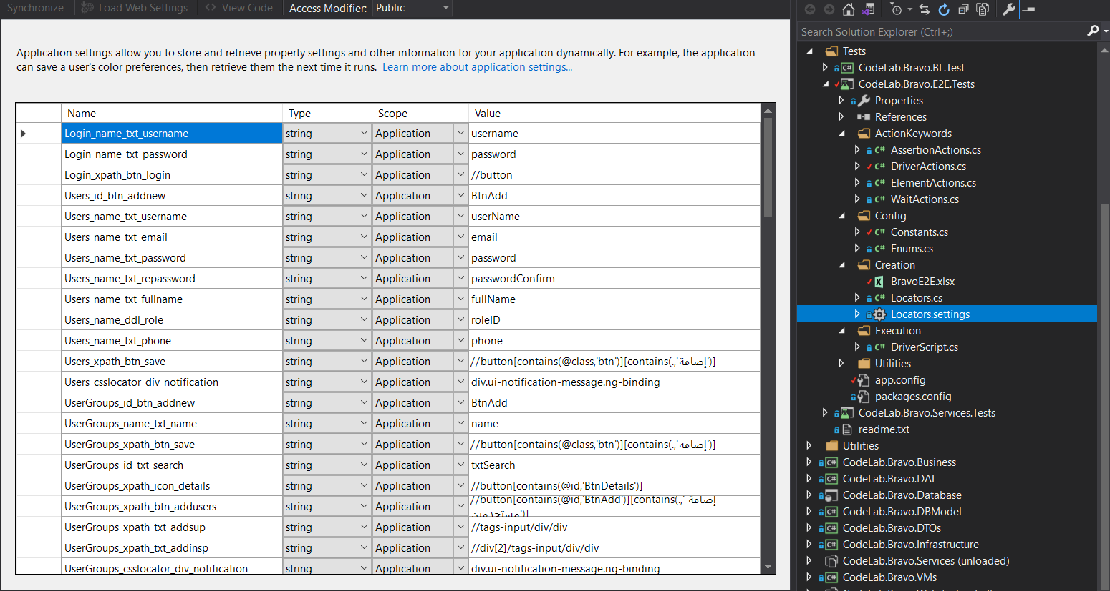
Locators

Slide 23
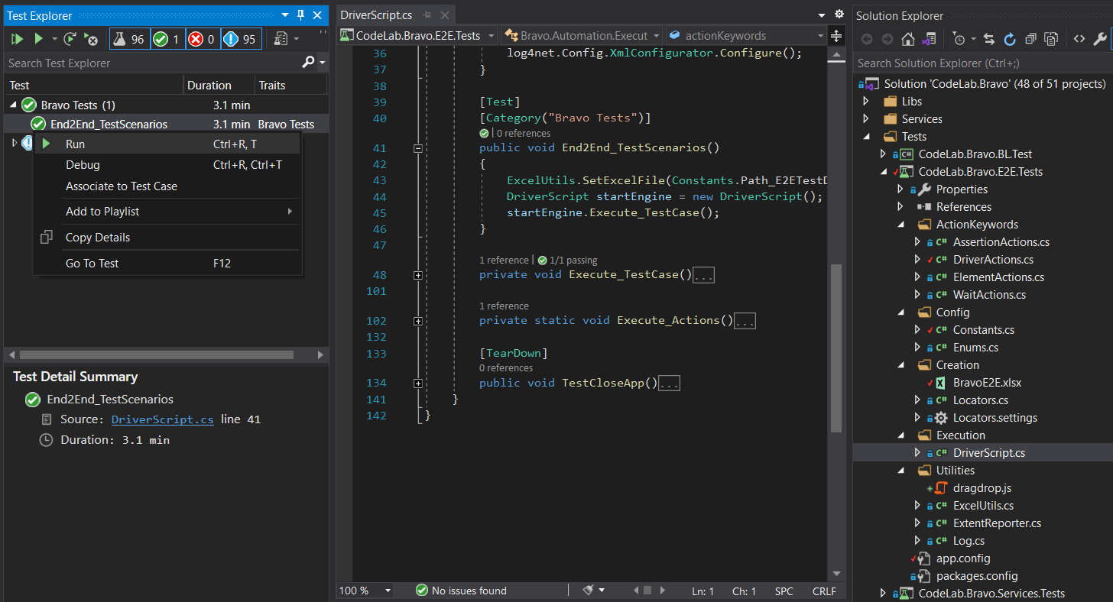
Test Execution

Slide 24
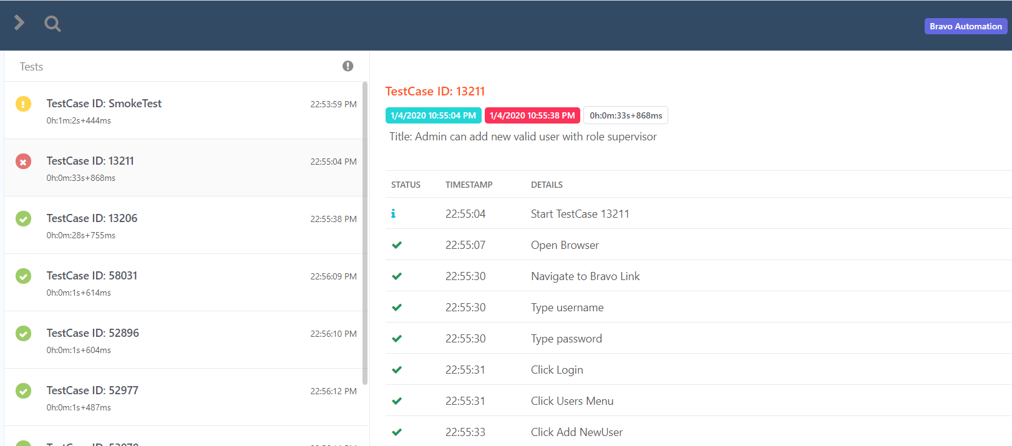
Reporting

Slide 25
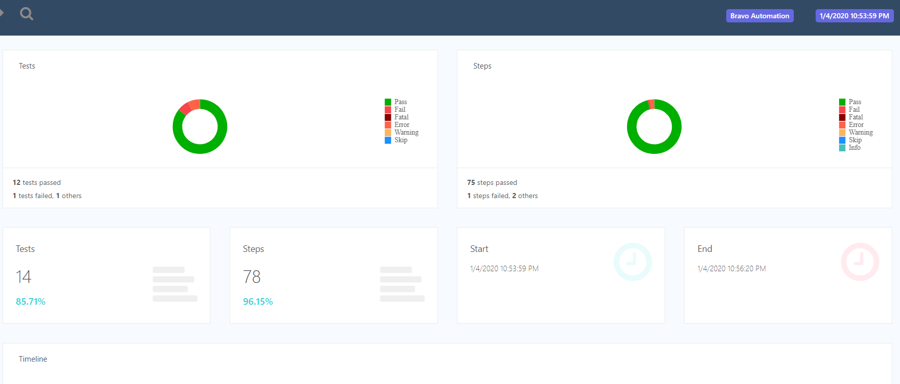
Monitoring

Slide 26
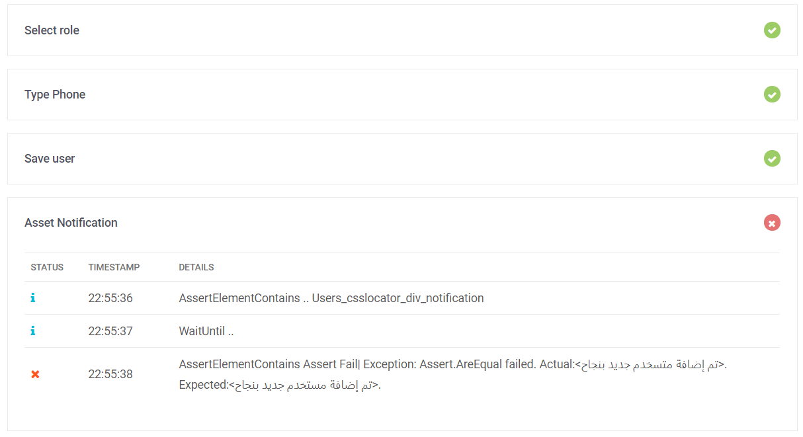
Logs

Slide 27
Continuous Integration

Slide 28
Continuous Integration
Create new Build and link to repository and branch
Add E2E visual studio test task
Queue new build

Slide 29
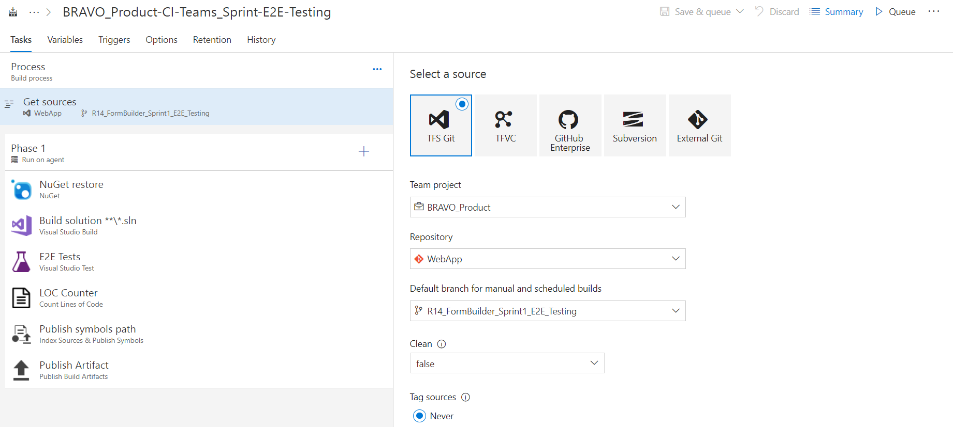
Continuous Integration
Create new Build and link to repository and branch

Slide 30
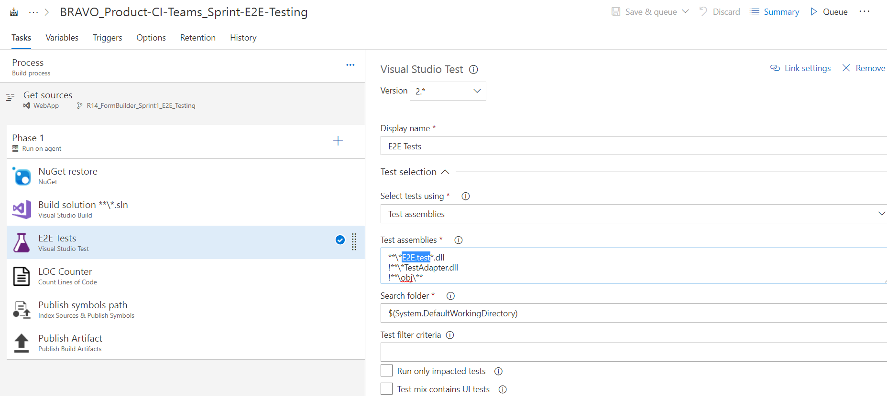
Continuous Integration
Add E2E visual studio test task

Slide 31
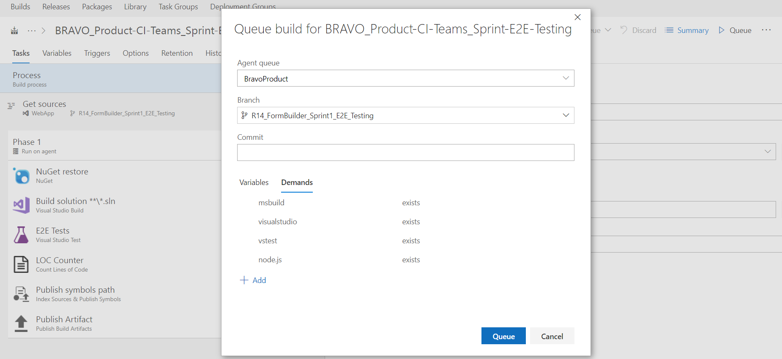
Continuous Integration
Queue new build

Slide 32
Continuous Improvement

Slide 33
State of main tasks
Task | Category | State
Keyword driven Framework | Framework Code | Done
Creation and Execution by Excel | Framework Code | Done
End to End test [Bravo] | Test script | Done
A set of most important tests [Bravo] | Test script | To Do
Modules Tests [Bravo] | Test script | To Do
Continuous Integration configuration | Continuous Integration | In Progress
Dynamic test data using DB | Framework Code | To Do
Using Separate server for CI | Continuous Integration | In Progress
Run test framework in All OS platforms | Framework Code | To Do
MAC POC to test iOS IPA | Framework Code | To Do
Resistant to UI changes [Fetch Elements Locators] | Framework Code | In Progress
Support Behavior Driven Development | Framework Code | In Progress
Using Container [Docker] | Continuous Integration | In Progress
Support Sending Mails | Continuous Integration | To Do
Creation and Execution By GUI | Framework Code | To Do
Add scheduler for tests | Framework Code | To Do
Add Metrics for test analysis | Framework Code | To Do

Slide 34
Thank You

